Slide 1
ARTIFICIAL INTELLIGENCE IN TRANSPORTATION INDUSTRY
Submitted in the partial fulfillment for the award of the degree of
BACHELOR OF ENGINEERING
IN
EBE CSE - AIML
CSE – ABBL
Submitted by:
VUPPUTURI BHARATH – 20BCS6586
GOTTIPALLI SAI PRASANTH-20BCS6832
KOYYADA AKSHAY KUMAR – 20BCS6369
KETHURI AJAY – 20BCS6585
Under the Supervision of:
SHUBHANGI MISHRA
Department of AIT-CSE
DISCOVER . LEARN . EMPOWER

Slide 2
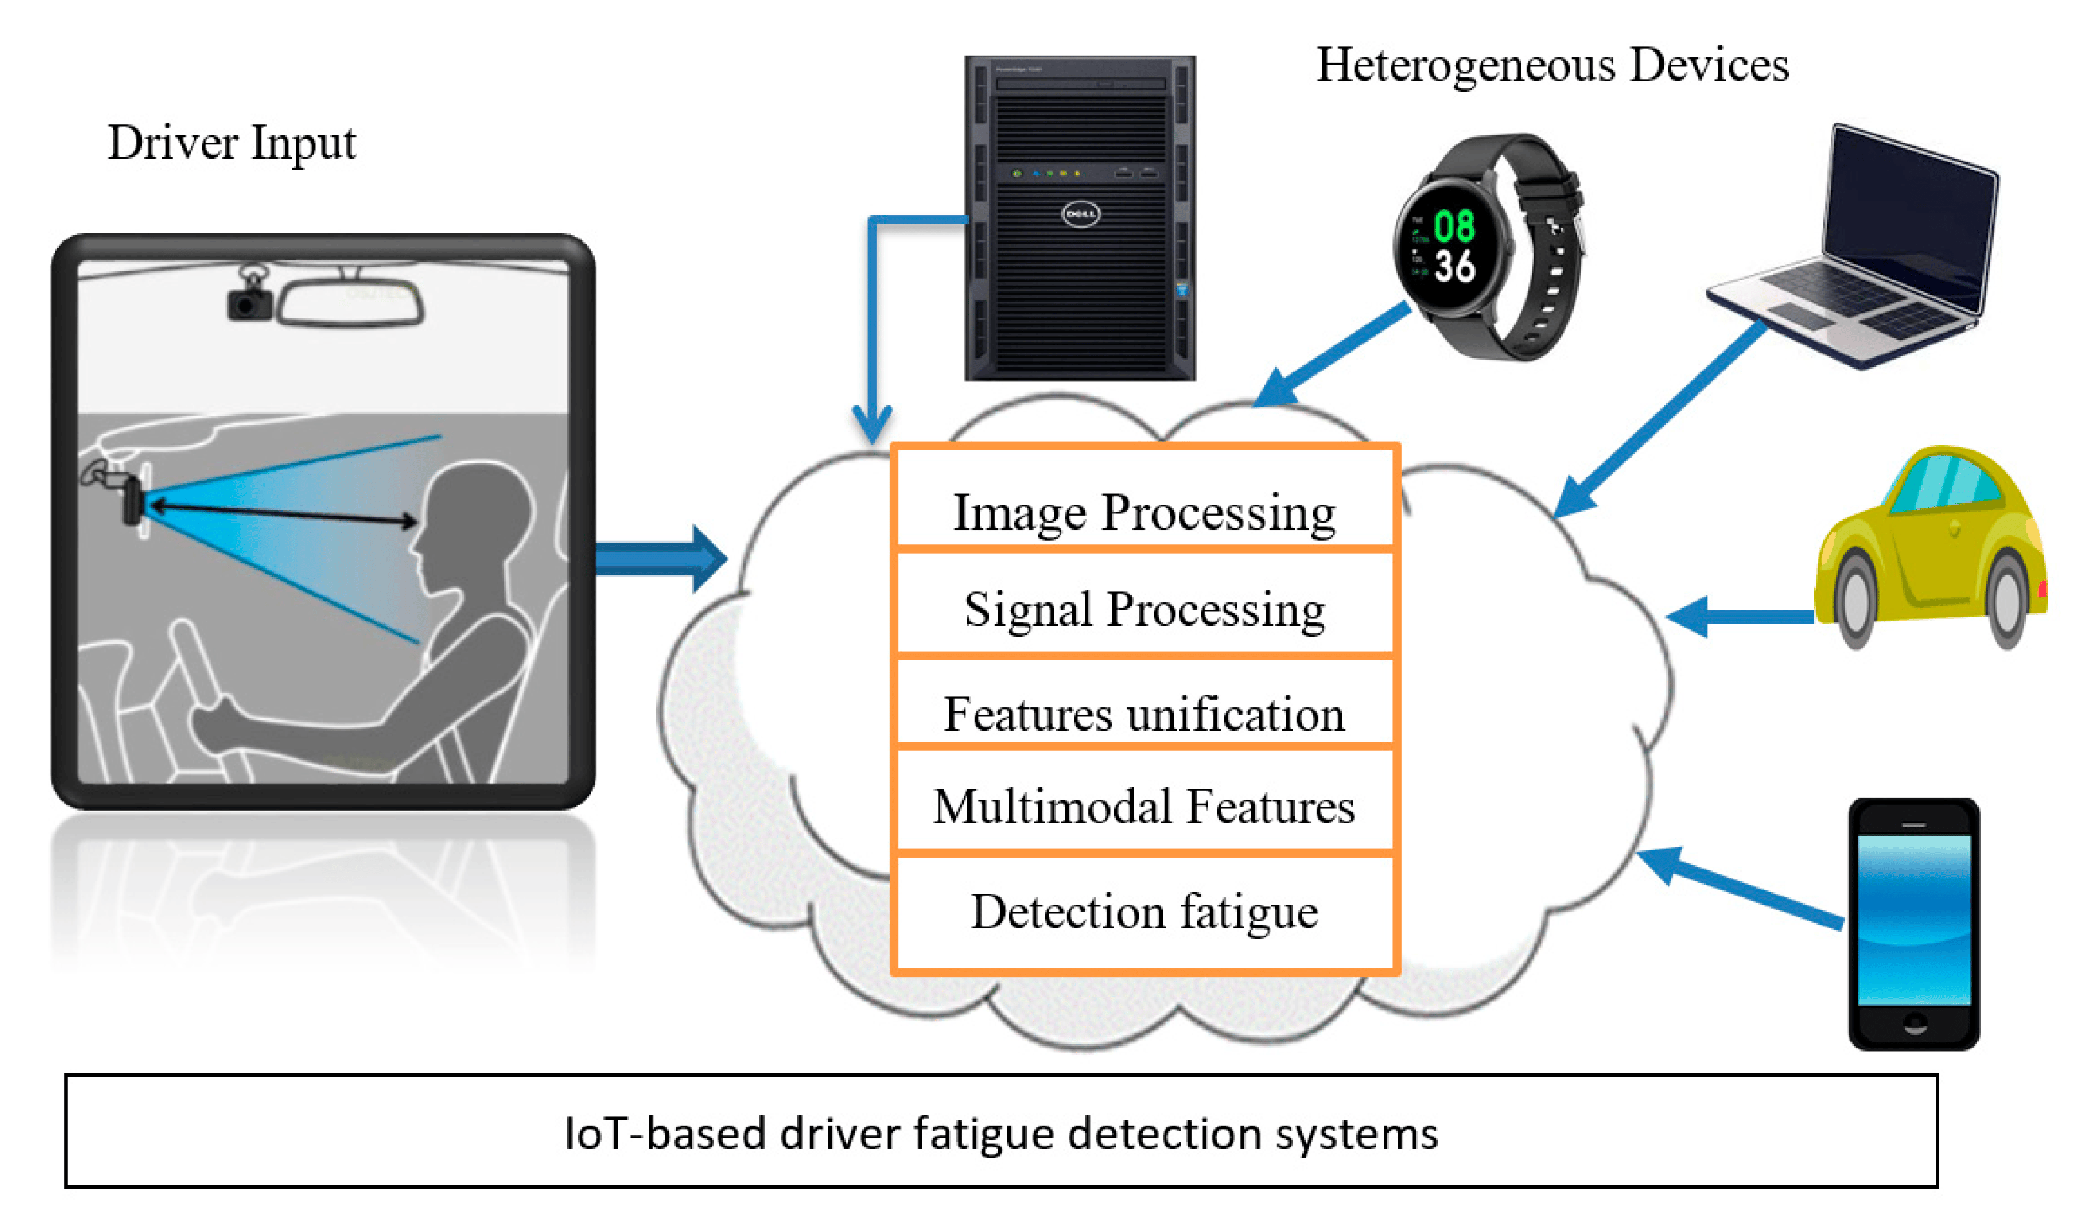
Preliminary Design
Driver fatigue is a major contributor to road accidents, causing numerous fatalities worldwide.
It is crucial to develop effective solutions
to address this problem.
Our preliminary design aims to detect
and alert drivers about their fatigue level,
reducing the risk of accidents.

Slide 3
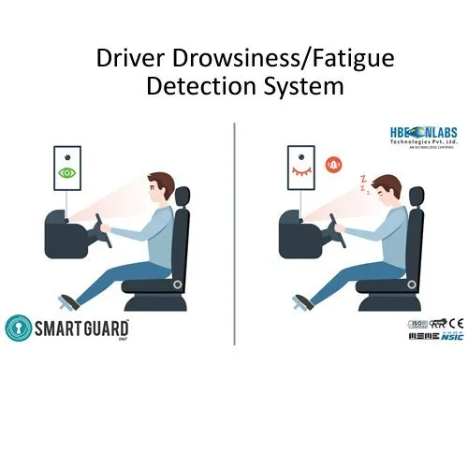
The driver fatigue monitoring system consists of the following components:
Sensors: Monitor physiological signals like
heart rate and eye movement
2. Data Processing Unit: Analyze sensor data and
determine fatigue level
Alert System: Provide visual and auditory alerts
to the driver
This integrated approach ensures accurate and timely fatigue detection.

Slide 4
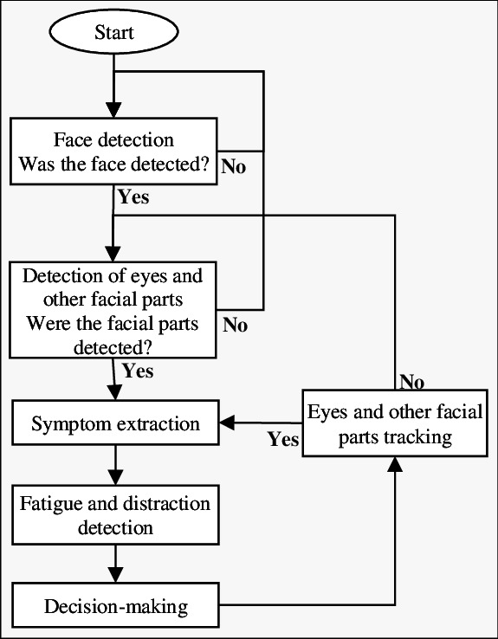
FLOWCHART

Slide 5

Methodology used
In this project, we will be using OpenCV for gathering the images from webcam and feed them into a Deep Learning model which will classify whether the person’s eyes are ‘Open’ or ‘Closed’.
The approach we will be using for this project is as follows:
Step 1 – Take image as input from a camera.
Step 2 – Detect the face in the image and
create a Region of Interest (ROI).

Slide 6
Step 3 – Detect the eyes from ROI and feed it to the classifier.
Step 4 – Classifier will categorize whether eyes are open or closed.
Step 5 – Calculate score to check whether the person is drowsy.
The problem at hand is to leverage Artificial Intelligence (AI) to create a comprehensive solution that enhances within the transportation industry. This encompasses areas such as road safety.
This system will alarm in the hypervigilance states including fatigue and distraction.
The data will be preprocessed and feature extracted and The system will then be implemented and evaluated.

Slide 7
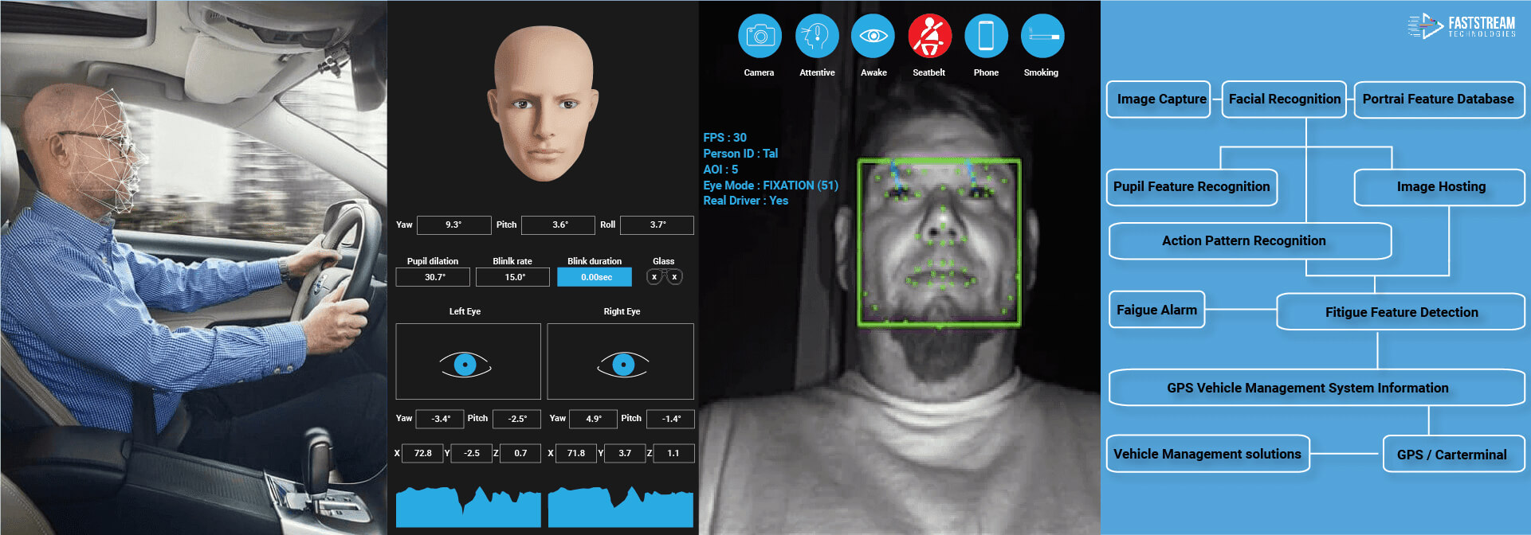
Analysis of Features
Driver drowsiness detection systems can use cameras, eye tracking sensors and other hardware to monitor visual cues, where drowsiness can be detected through yawning frequency, eye-blinking frequency, eye-gaze movement, head movement and facial expressions.

